Slide 1
Nexledger Accelerator Configuration and Test
张林超

Slide 2
Required Tools
Nexledger Accelerator (https://github.com/nexledger/accelerator)
Nexledger Innovation Sandbox (https://github.com/nexledger/innovation-sandbox)

Slide 3
Prerequisites
Go (1.11.0 or greater)
Docker (17.06.2-ce or greater)
Docker-compose (1.14.0 or greater)
NodeJS 8.X
node-gyp

Slide 4
Install Nexledger Accelerator
Download nexledger accelerator from GitHub
git clone https://github.com/nexledger/accelerator.git
Build accelerator
go build cmd/accelerator.go

Slide 5
Install Nexledger Innovation Sandbox
Download nexledger accelerator from GitHub
git clone https://github.com/nexledger/innovation-sandbox.git

Slide 6
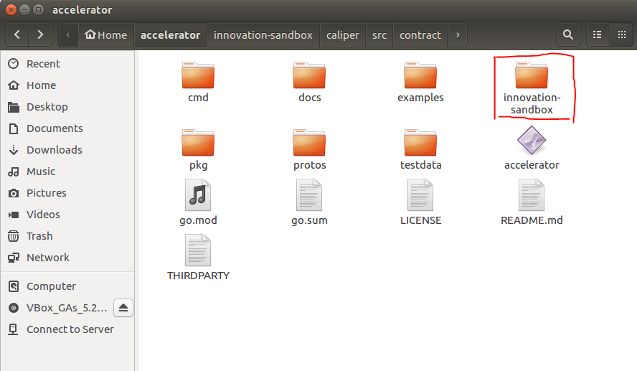
Configure Nexledger Accelerator
Copy the directory of innovation-sandbox into the folder of accelerator
Install the node modules from innovation-sandbox/caliper
npm install
Install the modules for the fabric through the following command in that folder
npm run fabric-v1.4-deps

Slide 7
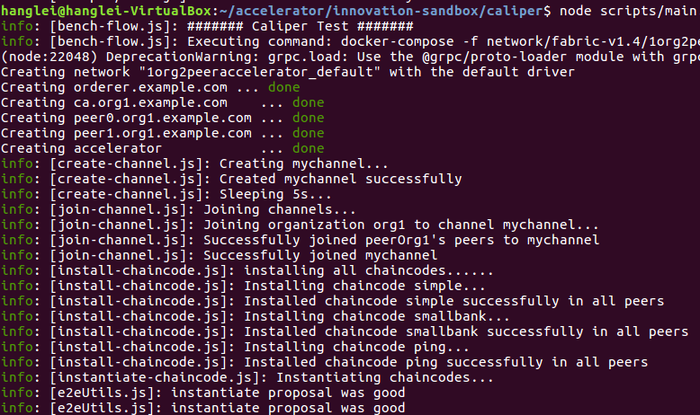
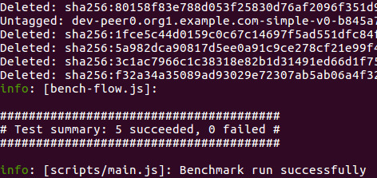
Run the Tests
The current version supports two benchmark scenarios, simple and smallbank which are provided by Caliper.
Move to caliper directory and run scripts/main.js with option. -c is a path to benchmark workload file and -n is a path to the blockchain configuration file.
For example, the following command executes the performance evaluation with Accelerator in 1 organization with 2 peers network.
node scripts/main.js -c benchmark/simple/config.yaml -n network/fabric-v1.4/1org2peeraccelerator/fabric-go.json

Slide 8
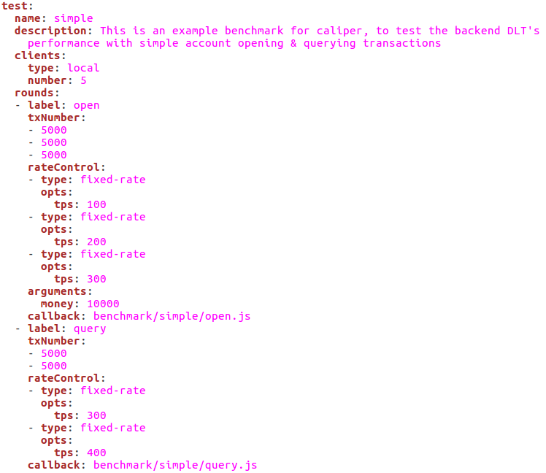
Benchmark Configuration
The benchmark is performed into five rounds
First round: 5000 transaction (open) with 100 send rate
Second round: 5000 transaction (open) with 200 send rate
Third round: 5000 transaction (open) with 300 send rate
Fourth round: 5000 transaction (query) with 300 send rate
Fifth round: 5000 transaction (query) with 400 send rate

Slide 9
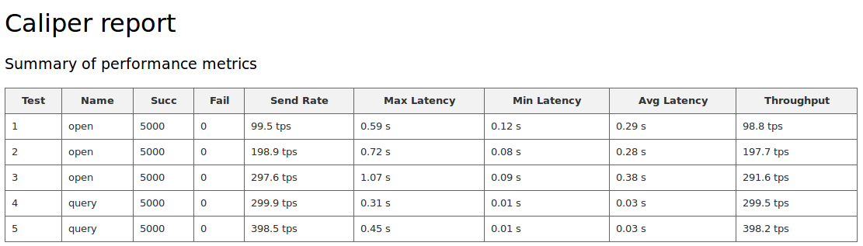
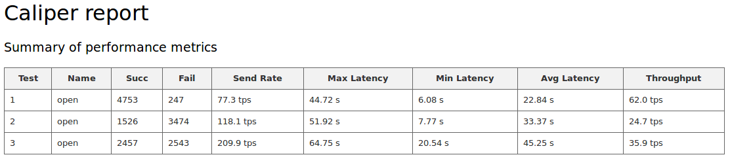
Test Result
The fourth and fifth round test are failed without Nexledger Accelerator.
The performance results indicate that Nexledger Accelerator can improve the tps significantly.
Performance Results With Nexledger Accelerator
Performance Results Without Nexledger Accelerator

